Slide 1
Coco Chanel
GABRIELLE BONHEUR " COCO " CHANEL
19 august 1883 - 10 january 1971

Slide 2
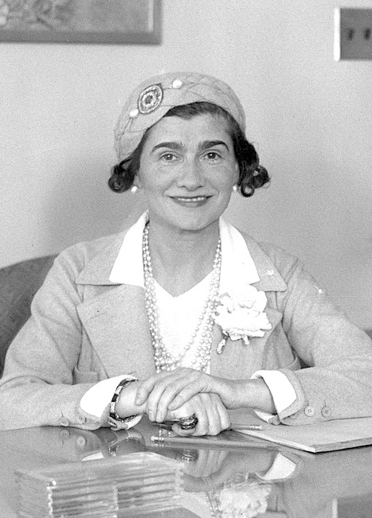
Coco Chanel
French fashion designer Chanel was born in Saumur in 1883 , grew up in an orphanage after her mother passed away
She was introduced to fabric in the monastery where she stayed and learned tailoring here and advanced in hat design.

Slide 3
EMBARRASSED HER OLD LIFE
Later in her life, Chanel told the story of her childhood in a slightly different way. She also often told stories that were not true and were further embellished.
She said that when her mother died, her father sailed for America to seek his fortune, and she was sent to live with her two aunts. She also claimed to have been born a decade later than 1883 and that her mother had died when she was much younger than 11.

Slide 4
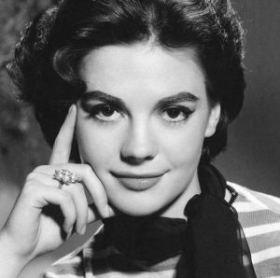
HOW SHE GOT HER NICKNAME ‘COCO’?
She got her nickname by singing 'Who has seen Coco?' while working in the popular entertainment center of the time as a young girl.
But she often liked to say that this nickname was given to him by his father.

Slide 5
FIRST WORK EXPERIENCES
For a while, Chanel looked for jobs where she could earn money by singing. Her beauty was very eye-catching but her singing voice was mediocre
Because she needed to find a job, he found a job at a famous mineral water brand. She worked here for a while as a seller of healing mineral water.
When the mineral water season ended, she returned to her old place to sing. Then she realized that she could not have a serious stage career.

Slide 6
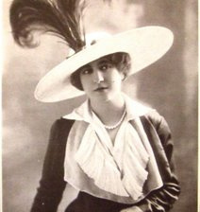
HOW SHE OFFICIALY STARTED HER CARRIER
Chanel met Étienne Balsan, a young French ex-military officer and textile heir.
Chanel had begun designing hats while living with Balsan, initially as a pastime but evolving into a commercial venture.
In 1910, she became a licensed milliner and opened a boutique, Chanel Modes, at 21 rue Cambon in Paris.
Since this location was already home to an established clothing business, Chanel sold only her hat designs at this address.
Chanel's millinery career began when stage actress Gabrielle Dorziat wore her hats in Fernand Nozière's play Bel Ami in 1912.

Slide 7
COMPETITIVE ANALYSIS
Chanel was planning to rise slowly and be at the top, but many of the men she loved who came her way gave her more power each time.
A man closed Chanel's store after ending his relationship. Another man bought the majority shares of Chanel's signature perfume 'Chanel No:5'
But apart from these types of relationships, she also had a relationship that respected her.
Chanel's longest relationship was with Misia Sert.Misia is said to have been attracted to Chanel for her "genius, lethal wit, sarcasm and wild subversion that fascinated and terrified everyone." Both women were educated in a convent and maintained a friendship with common interests and secrets. They also shared their drug use. By 1935, Chanel was a habitual drug user who injected herself with morphine on a daily basis, a habit she continued until the end of her life.

Slide 8
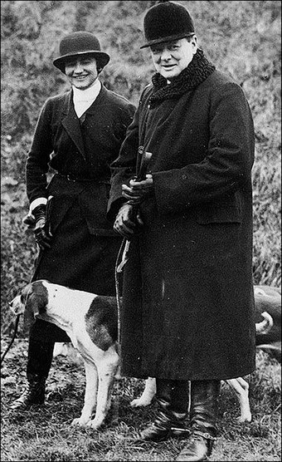
HER LEGENDARY BEAUTY
Chanel was a very attractive woman. It was an elite group of associations that revolved around figures such as the aristocratic politician Winston Churchill, peers such as the Duke of Westminster, and royals such as Edward, Prince of Wales.
The Duke gifted Chanel with stunning jewellery, expensive works of art and a house in London's prestigious Mayfair district. His relationship with Chanel lasted ten years.
During Chanel's affair with the Duke of Westminster in the 1930s, her style began to reflect her personal feelings. Her inability to reinvent the little black dress was a sign of such reality. He began designing a "less is more" aesthetic.

Slide 9
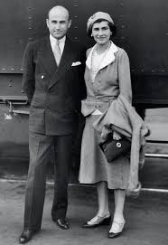
Hollywood Experince
Chanel met Samuel Goldwyn while in Monte Carlo in 1931. Goldwyn made an attractive offer to Chanel. In exchange for one million dollars (about US$75 million today), he would take her to Hollywood twice a year to design costumes for its stars. Chanel accepted the offer. On her first trip to Hollywood, she was accompanied by her friend Misia Sert.
Chanel designed the clothes worn by Gloria Swanson in 'Tonight or Never' (1931) and Ina Claire in 'The Greeks Had a Word for Them' (1932). Both Greta Garbo and Marlene Dietrich became private clients.
Her experience with American film production left Chanel with a distaste for the Hollywood film industry and a disgust for the culture of the film world, which she called "childish." Chanel's verdict was: "Hollywood is the capital of bad taste... and vulgar." As a result, the design aesthetic did not translate well to the film.
Samuel Goldwyn and Coco Cahnel

Slide 10
COMPETITION WITH SCHIAPARELLI
Chanel's designs for movie stars in Hollywood were not successful and did not increase her reputation as expected. More importantly, Chanel's star had been eclipsed by her chief rival, designer Elsa Schiaparelli.
Schiaparelli's innovative designs, full of playful references to surrealism, were receiving critical acclaim and creating enthusiasm in the fashion world. Feeling that she had lost her avant-garde direction.
Chanel collaborated with Jean Cocteau on the stage play Oedipe Rex. The costumes he designed were ridiculed and critically panned: "The actors, wrapped in bandages, looked like walking mummies or victims of a terrible accident." He also took part in the costuming of the Ballets Russes de Monte Carlo production of Baccanale. The designs were made by Salvador Dalí. However, the ballet had to leave London due to Britain declaring war on 3 September 1939. They left the costumes in Europe and they were redone by Karinska based on Dali's initial designs.

Slide 11
World War II
In 1939, At the beginning of World War II, Chanel closed her stores and retained her apartment above the fashion house at 31 Rue de Cambon.
After the war, Chanel fled to Switzerland to avoid criminal charges for collaborating as a Nazi spy.
One of the most important missions in which he participated was Operation Modellhut ("Operation Model Hat"). His mission was to act as a messenger from Hitler's Foreign Intelligence to Churchill and prove that part of the Third Reich was attempting peace with the Allies.
Chanel's old friend Churchill prevented Chanel from being punished for her espionage collaborations and enabled her to save her inheritance.

Slide 12
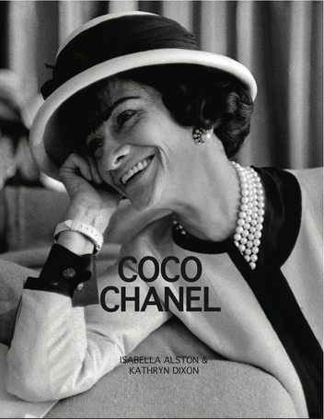
AFTER THE WAR
Chanel moved to Switzerland in 1945 and lived there for several years, spending some of her time with Dincklage.
After the war, names such as Christian Dior and Cristóbal Balenciaga came to the fore in women's fashion.
At the age of over 70, she felt it was time to re-enter the world of fashion after her couture house had been closed for 15 years. Chanel came out with its comeback collection in 1954.

Slide 13
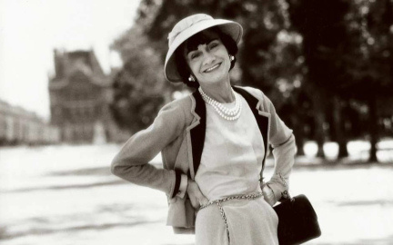
Her Death
While he was going through his routine of preparing the Spring 1971 catalogue, one day he felt unwell and went to bed and said his last words to his Maid: "You see, that's how you die."
She died on Sunday, January 10, 1971, at the Ritz Hotel, where she had resided for more than 30 years.
Fashion leaders such as Cristóbal Balenciaga, Salvador Dalí and Yves Saint Laurent attended her funeral.

Slide 14
Even after Chanel died as a fashion designer, the designs she made in the 1920s are still adapted and sold in different ways today.
Chanel shaped fashion by adapting fabrics in an innovative way, combining clothes with different cultures, trying to make clothing more comfortable and practical for women like inspired by military bags; it introduced shoulder strap bags for women to use their hands more comfortably, she inspired fashion with the concept of "little black dress".
In 1920, Chanel vowed to dress all women in black while watching an audience at the opera.

Slide 15
Thank you!
FOR WATCHING
Melisa Mina Karaman

